Slide 1
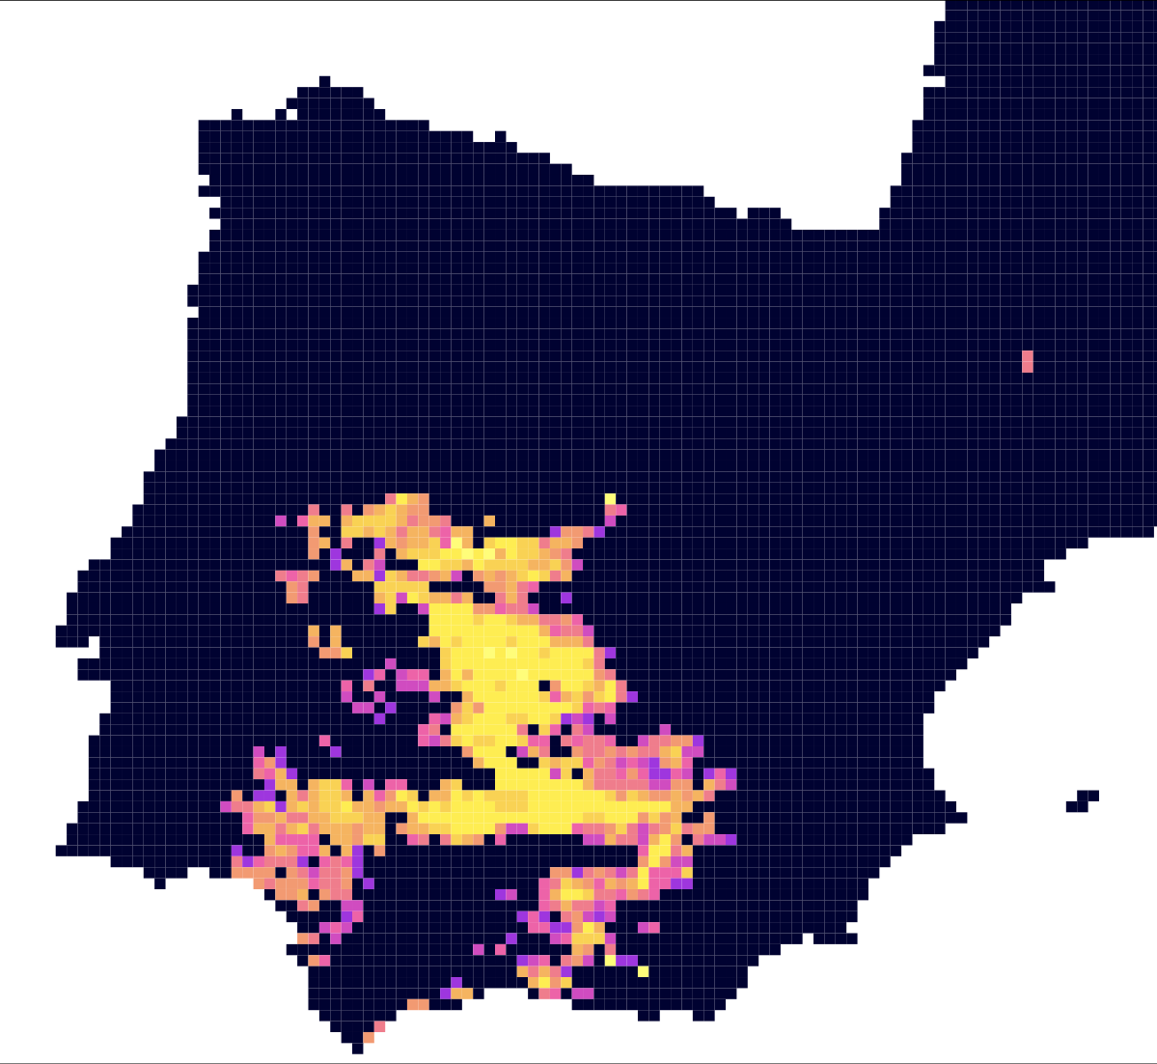
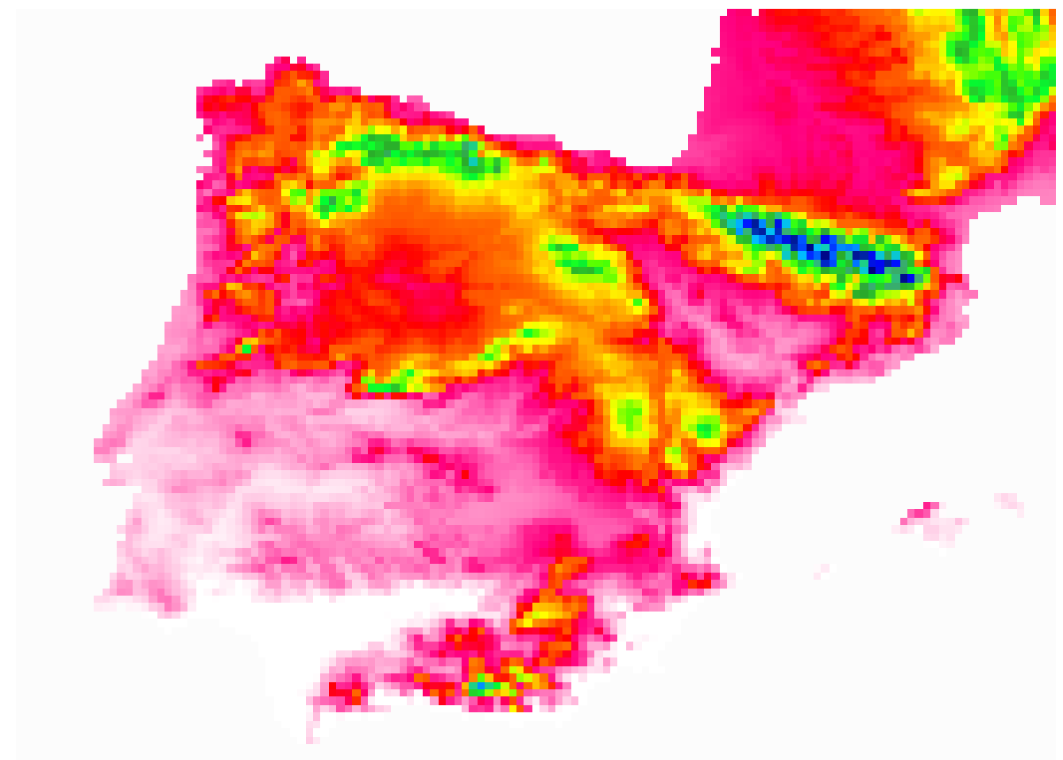
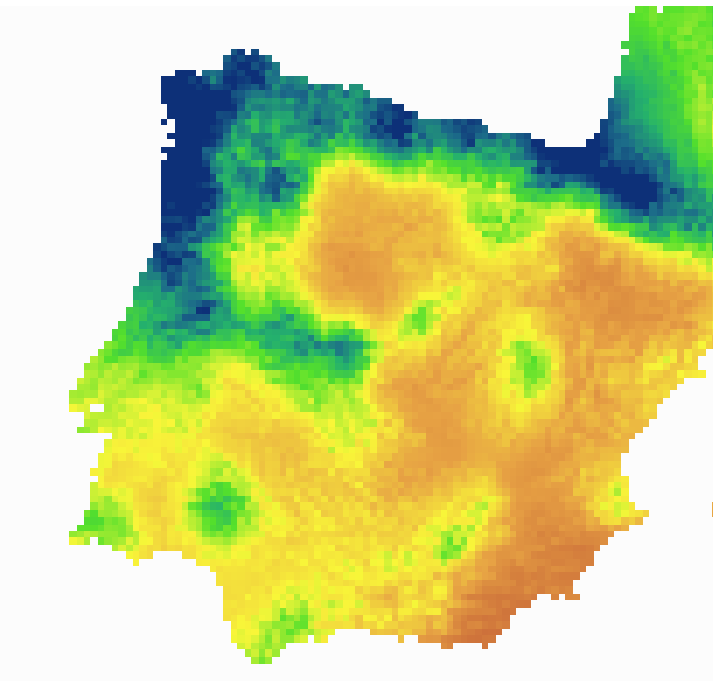
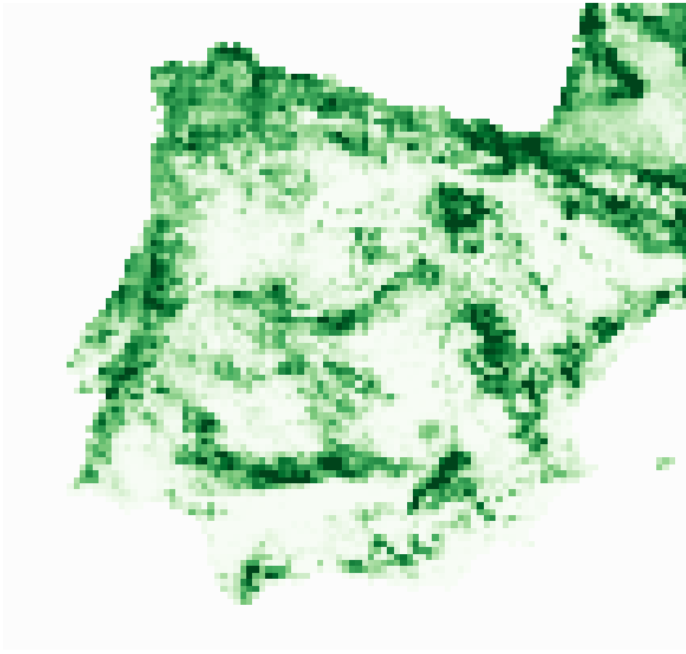
Biodiversity Data
GBIF records
cleaned
thinned
Pseudo absences
Ecological Niche Model-Algorithms
GLM
GAM
SRE
MAXENT
Ensemble Forecast
Weighted mean by performance measured as TSS
Dispersal simulations
Negative exponential dispersal
Variable selection
Environmental Data
CHELSA Bioclim
Land Cover Fractions
OSM Motorways
Landsat Metrics
Topography
Dispersal barriers
Built-up land fraction - motorways

